Slide 1
Bioinfo module WS 25/26
“Differential expression and Batch effects”
Johannes Wolter

Slide 2
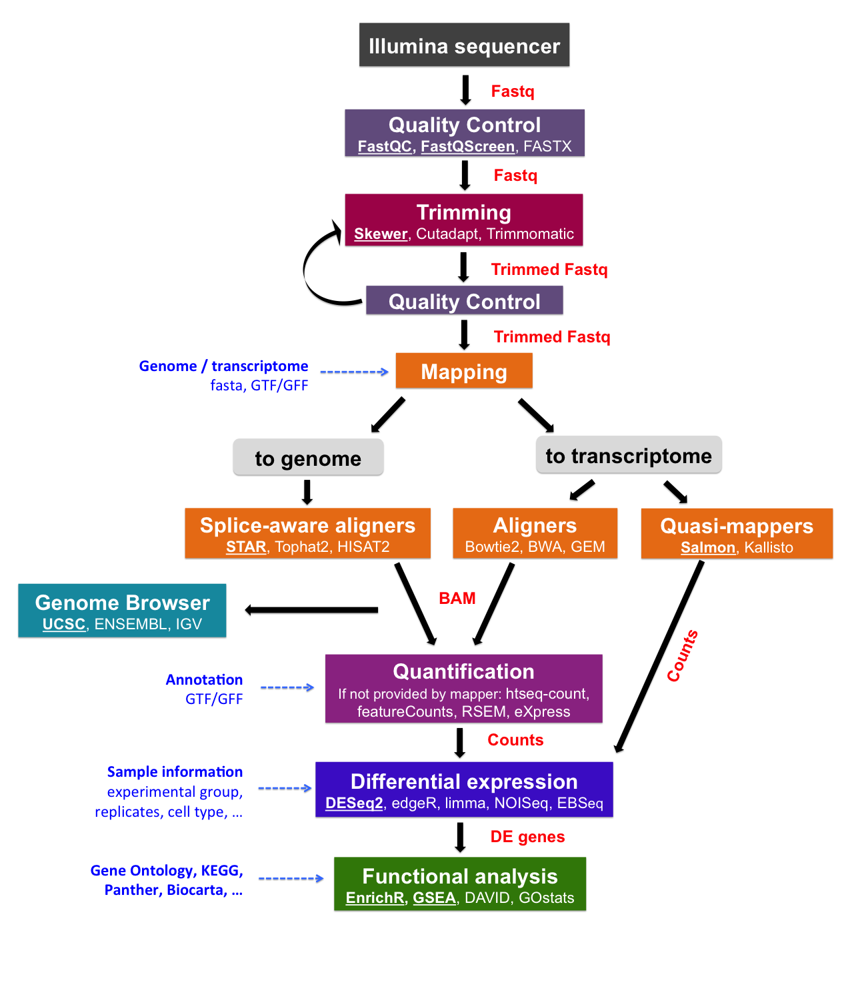
RNA-Sequencing
Sequencing
Quality control
Mapping
Counts
Differenftial expression (which genes are expressed at different levels between conditions)
4
https://biocorecrg.github.io/RNAseq_course_2019/alignment.html

Slide 3
RNA-Sequencing
Sequencing
Quality control
Mapping
Counts
Differenftial expression (which genes are expressed at different levels between conditions)
Batch Effects?
?
?
?
?
4
https://biocorecrg.github.io/RNAseq_course_2019/alignment.html

Slide 4
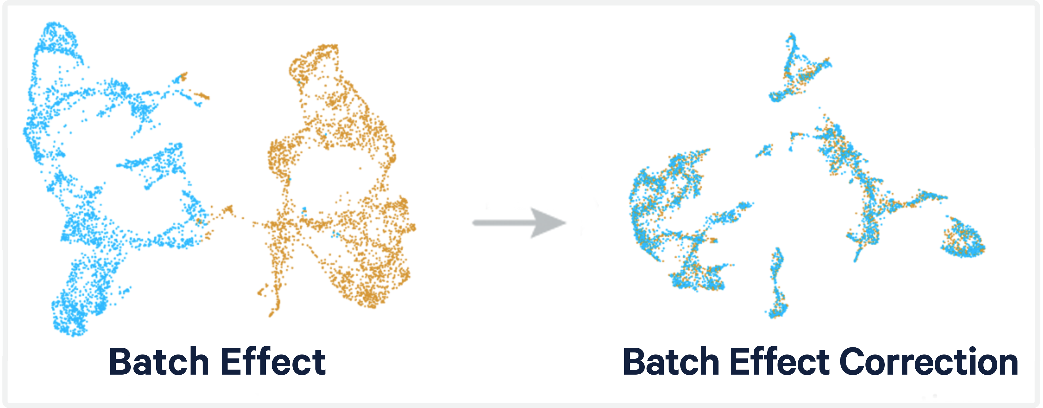
Batch Effects and Batch Correction
from: https://www.10xgenomics.com/analysis-guides/introduction-batch-effect-correction
1

Slide 5
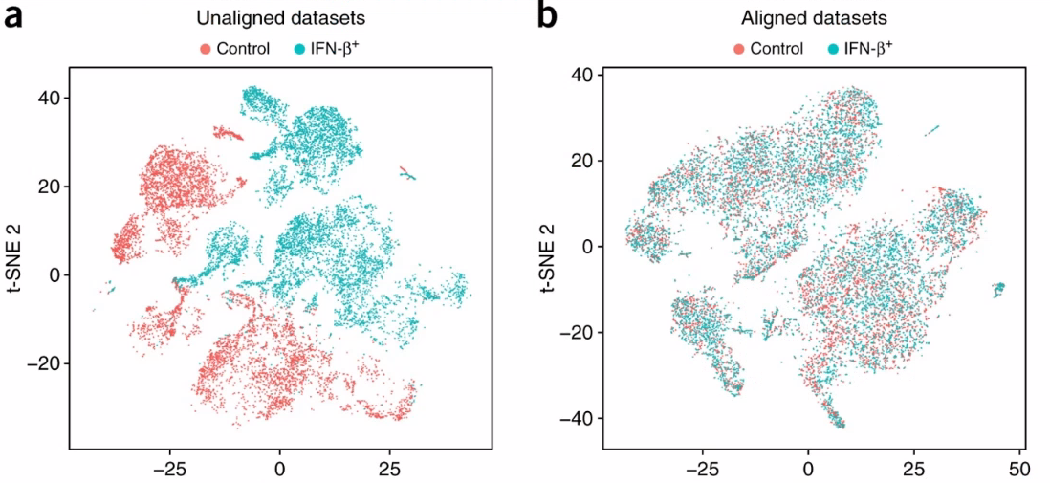
Batch effects and batch correction

Slide 6
Batch Effects and Batch Correction
Batch effects are unwanted artifacts or noise in the data that are not associated with the biological condition
Often labelled as “batch effects” because they become apparent when analysing different batches
Sources for batch effects or artifacts in the data are numerous and diverse. Biological circumstances can also lead to unwanted artifacts in the data
  Biological sources e.g.: biological sex, age, ethnicity, …
  Technical sources e.g.: different handlers, base mismatch, average base quality, …
2

Slide 7
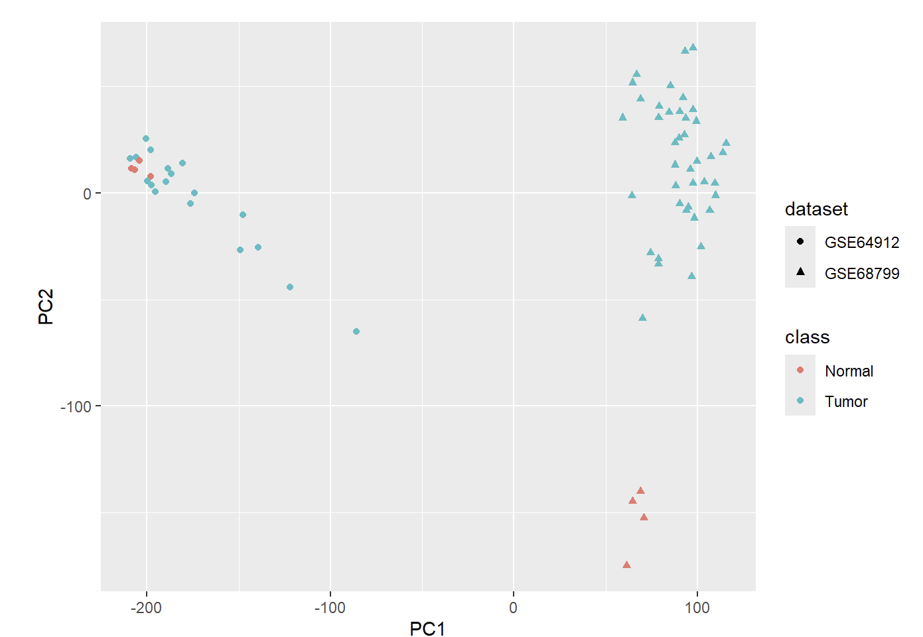
Dimension Reduction
How can we imagine and visualize highly complex data?
Dimension reduction techniques
Explained variance in the data
Different techniques
Pca, umap, t-sne
2

Slide 8
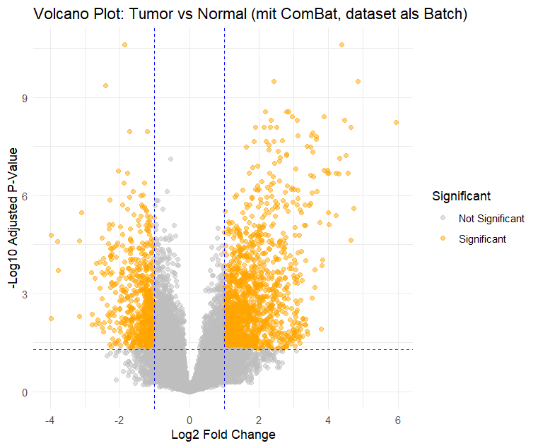
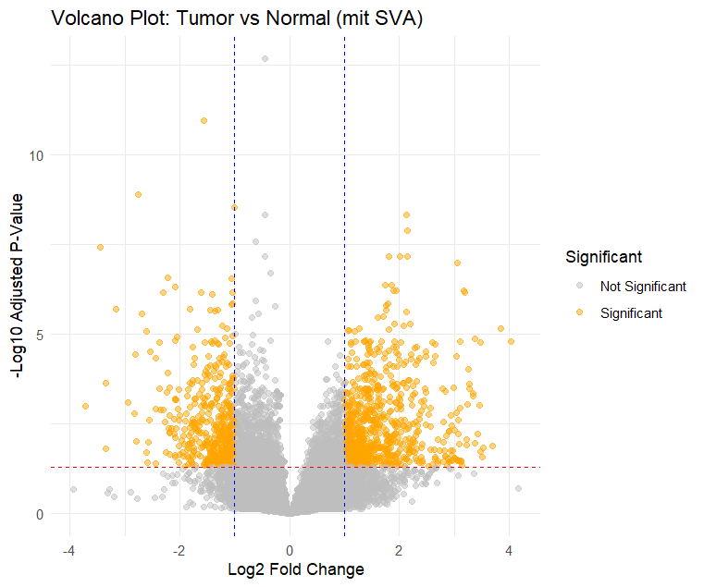
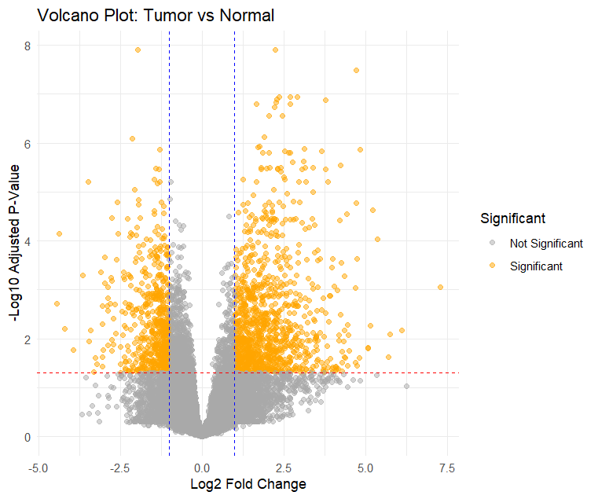
Batch-Effects?

Slide 9
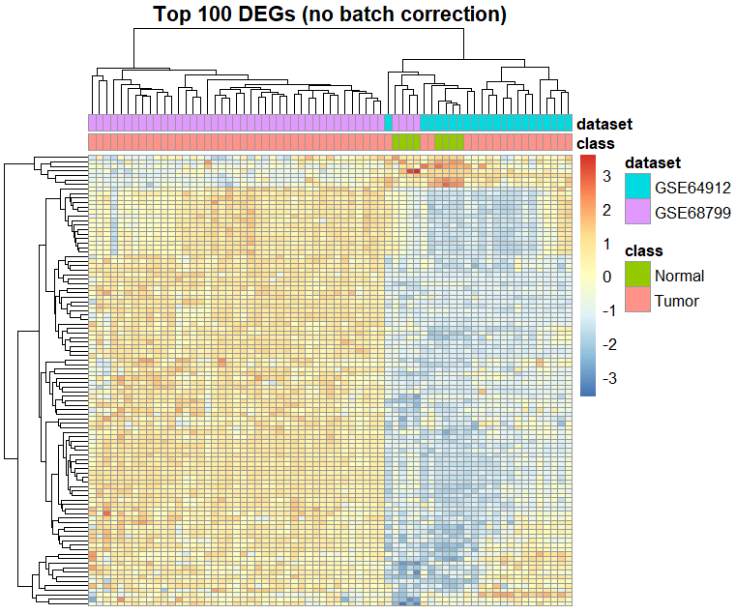
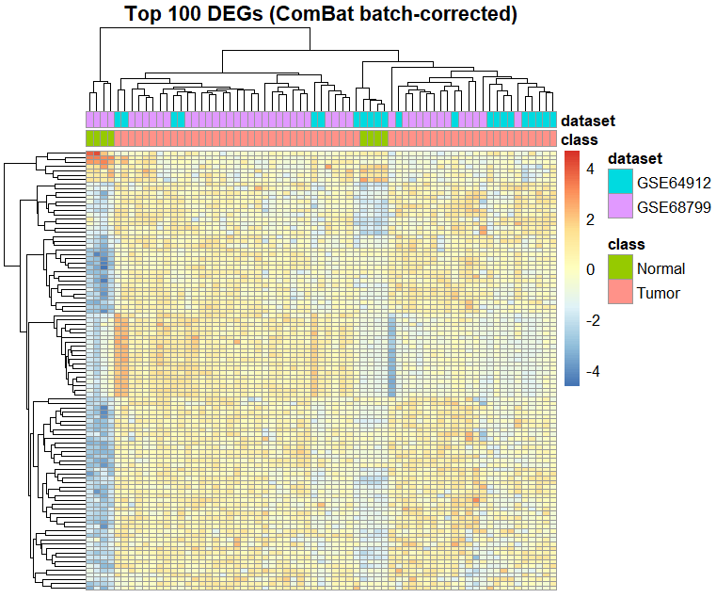
Batch-Effects?

Slide 10
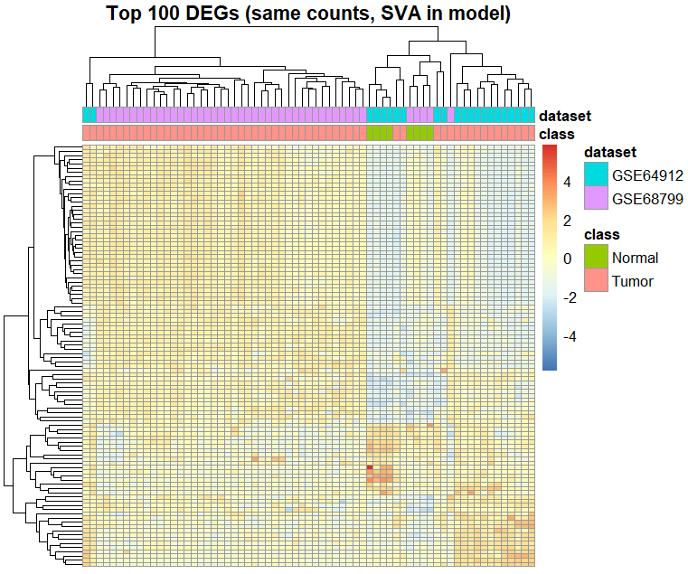
Batch-Effects?

Slide 11
Is Batch Correction necessary? Is it dangerous?
As often in biology… it depends
There is a ground truth in every dataset, but we dont know what it is
Batch correction good:
  Information about batches, patients, … is known and available
  We already have experience with similar data (for example we know of changes between a specific tumor and controls)
  Dimension reduction reveals obvious changes between datasets that do not stem from biological sources
Batch correction bad (or rather difficult):
  Additional metadata about datasets, patients, …. Is not available
  Researching new data, where experience and other information is limited (Note: it does not mean that batch correction is not necessary, it just means that you have to be somewhat conservative with correcting
  Potential batch effects and biology are mixed -> we cannot measure what is what

Slide 12
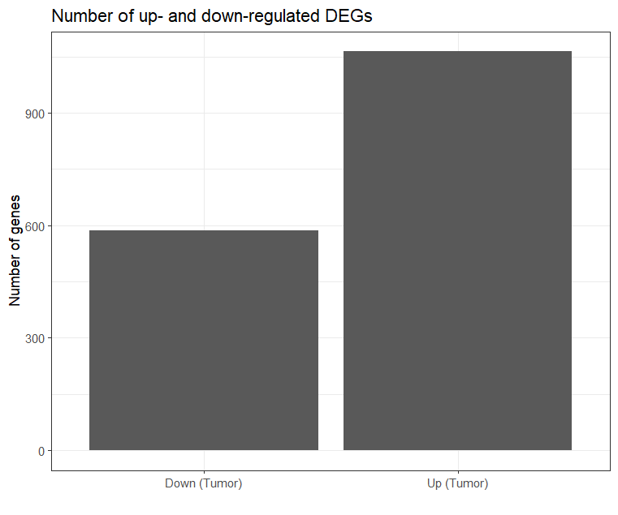
Pathways analysis
Different expression of genes depending on their condition
(Tumor vs Normal, Treated vs Untrested, …)
Shows no genes, but pathways that these Genes interact with
Gives targets for potential medication, for example when you have a list of drugs that up or downregulate are specific pathway
Can be the start to another downstream analysis to focus on a specific pathway

Slide 13
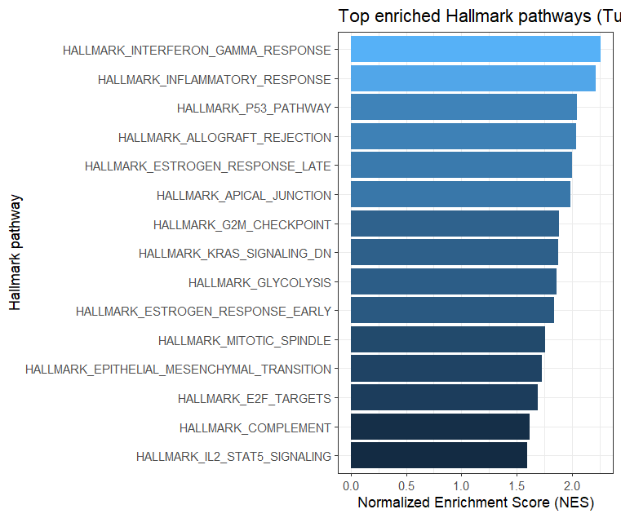
Pathways analysis
Different expression of genes depending on their condition
(Tumor vs Normal, Treated vs Untrested, …)
Shows no genes, but pathways that these Genes interact with
Gives targets for potential medication, for example when you have a list of drugs that up or downregulate are specific pathway
Can be the start to another downstream analysis to focus on a specific pathway

Slide 14
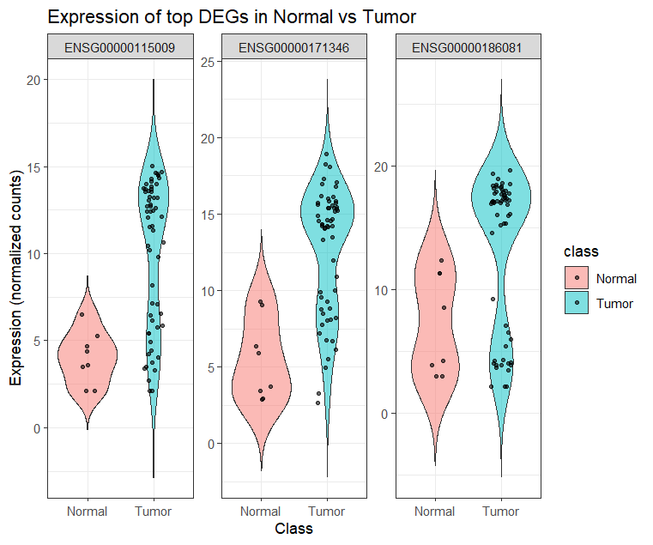
Pathways analysis
Different expression of genes depending on their condition
(Tumor vs Normal, Treated vs Untrested, …)
Shows no genes, but pathways that these Genes interact with
Gives targets for potential medication, for example when you have a list of drugs that up or downregulate are specific pathway
Can be the start to another downstream analysis to focus on a specific pathway

Slide 15
Why do a Differential Gene Expression Analysis
Difference in gene expression between healthy and diseased state
Differentially expressed genes (DEGs) often belong to important pathways, and insights into these changes can help to understand disease progression
Identifies potential biomarkers for diagnostics.
Finds candidate genes for drug development or for resuing established drugs
Can helps predict patient response to therapies.
2

Slide 16

What would you actually use a workflow like in the course for???
Let us have a look at a (not very real but) maybe interesting example…

